Slide 1
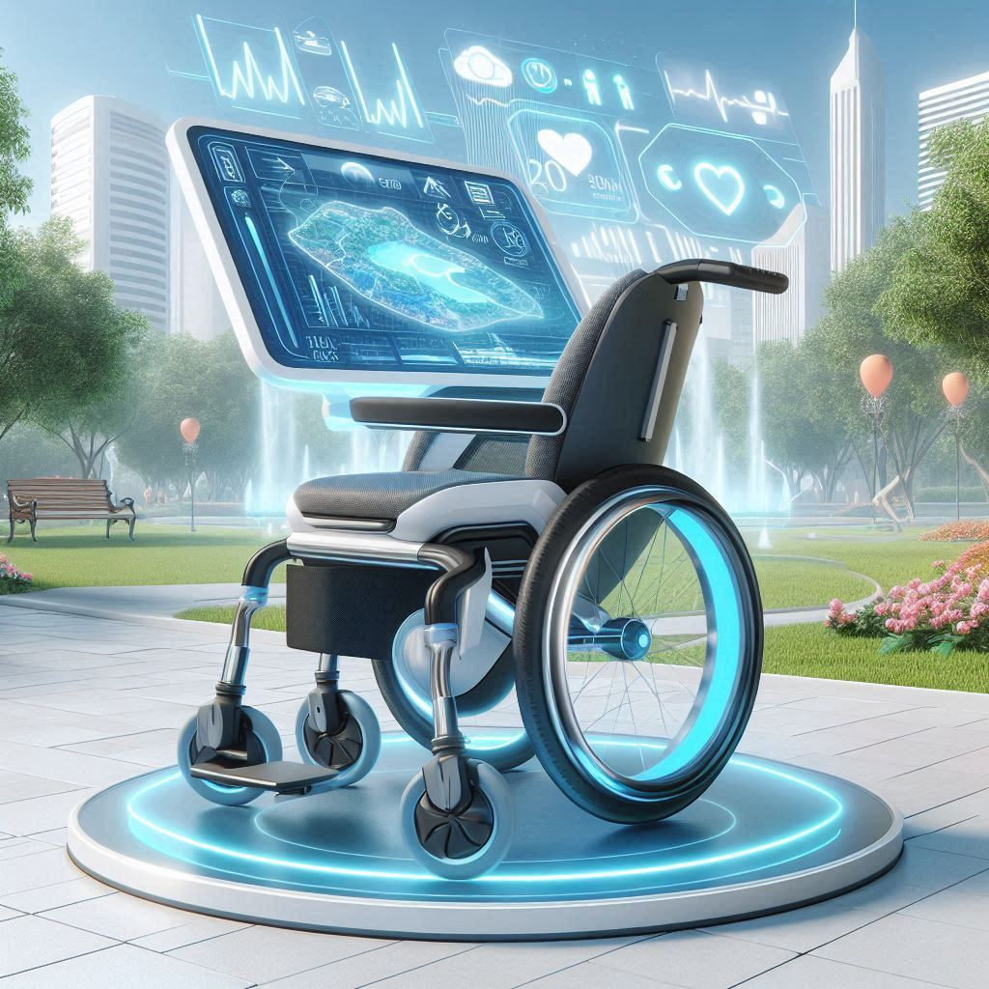
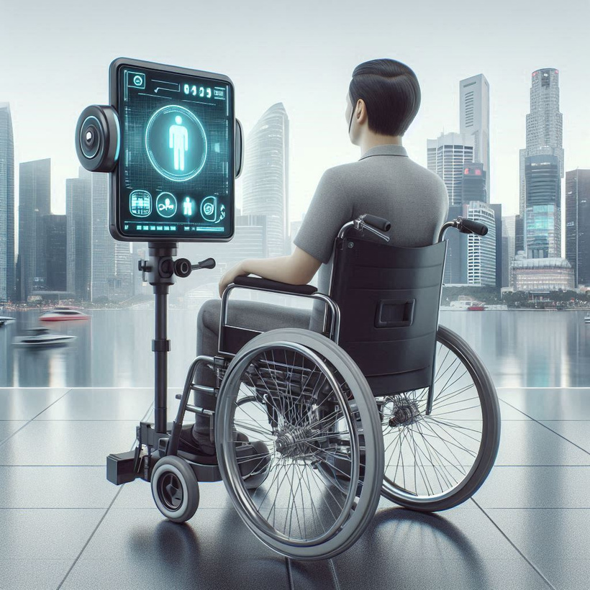

Smart Wheelchair for persons with disabilities in lower body and hearing impairements
Project ID
24 – 25J - 048

Slide 2
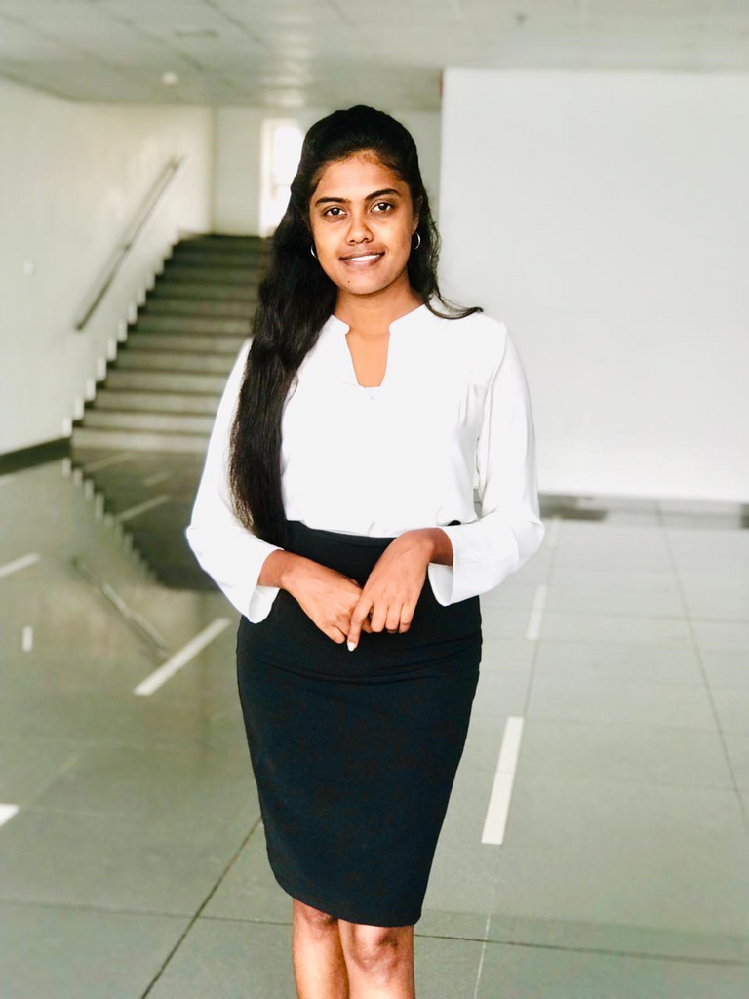



OUR TEAM
T.M.S.Thennakoon
H.G.K.D.Premathilaka
S.N. Benthotage
A.W.D.M. Samarawickrama
Team Leader
Member
Member
Member

Slide 3

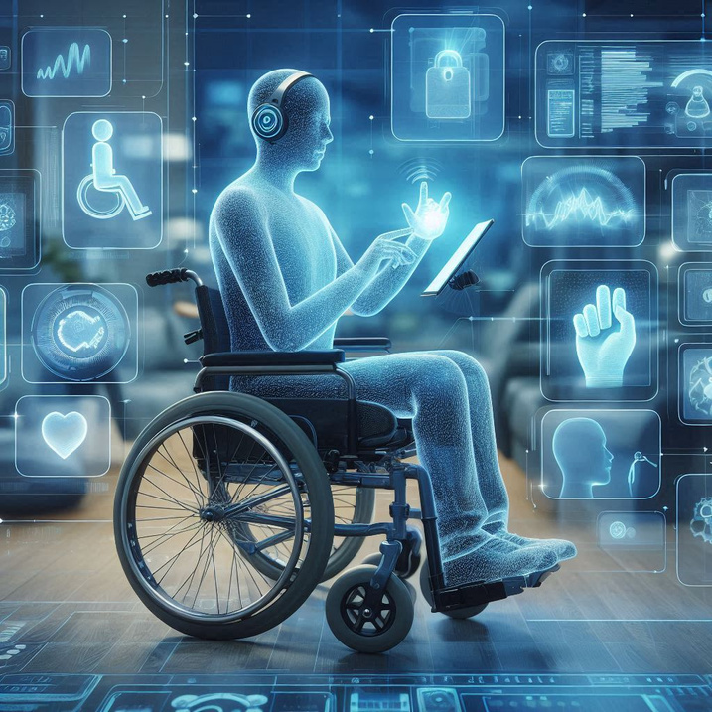
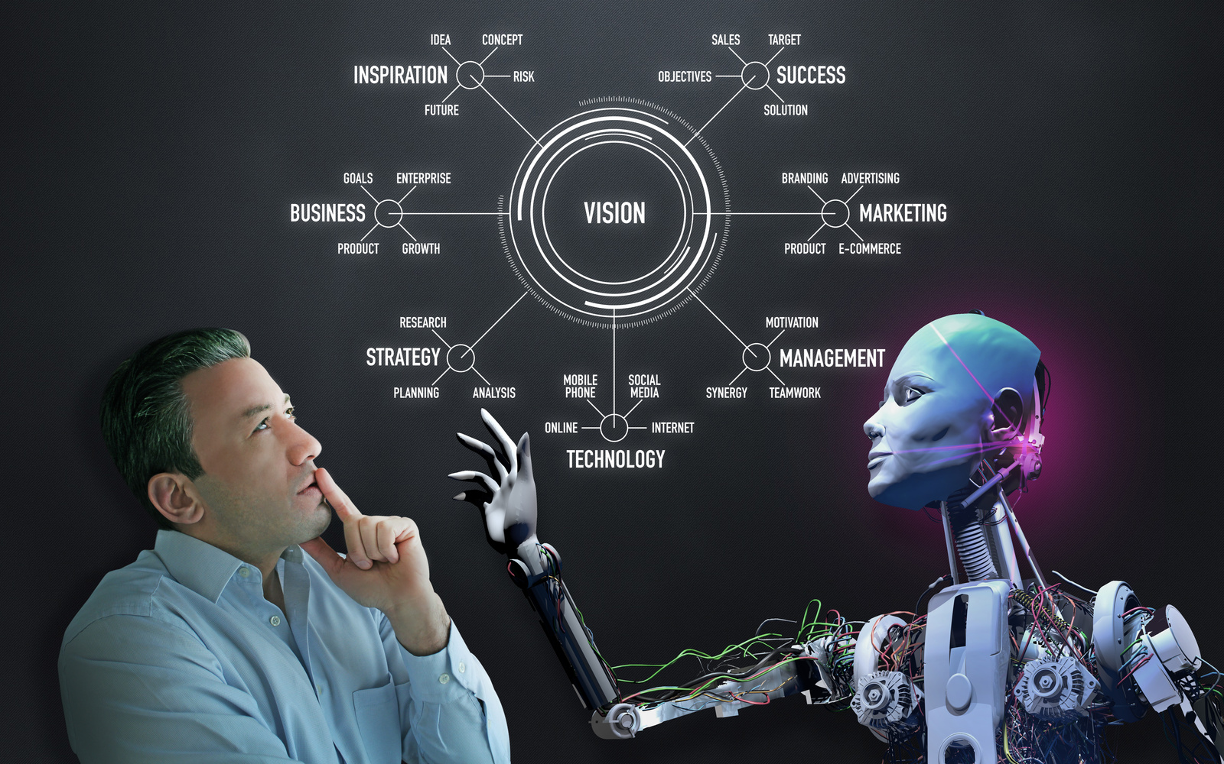
INTRODUCTION
The rising population of individuals with lower body disabilities and hearing impairments presents a challenge for current assistive devices. Traditional wheelchairs and aids lack advanced features like adaptive interfaces and real-time health monitoring, limiting user independence and increasing caregiver reliance. Innovative solutions are essential to enhance mobility, ensure safety, and provide personalized support for improved quality of life.

Slide 4

Research Question
How can we develop advanced mobility solutions that enhance independence for individuals with lower body disabilities, addressing their unique challenges?
What innovative technologies can be integrated to improve safety, communication, and care for hearing-impaired users, considering their specific needs?
How can we create comprehensive systems that not only reduce caregiver burden but also provide personalized health monitoring and support for individuals with disabilities?

Slide 5
MAIN OBJECTIVE
To create an intelligent smart wheelchair that improves mobility, accessibility, and quality of life for individuals with lower body disabilities and hearing impairments by integrating advanced navigation, real-time tracking, health monitoring, and personalized exercise features.
SUB OBJECTIVES
Develop sign language control for hearing-impaired users to navigate the wheelchair.
Implement pathfinding with real-time tracking and task reminders for enhanced mobility.
Integrate a health monitoring system to continuously track and manage vital signs.
Create an adaptive exercise plan with real-time motion detection for personalized physical therapy.

Slide 6

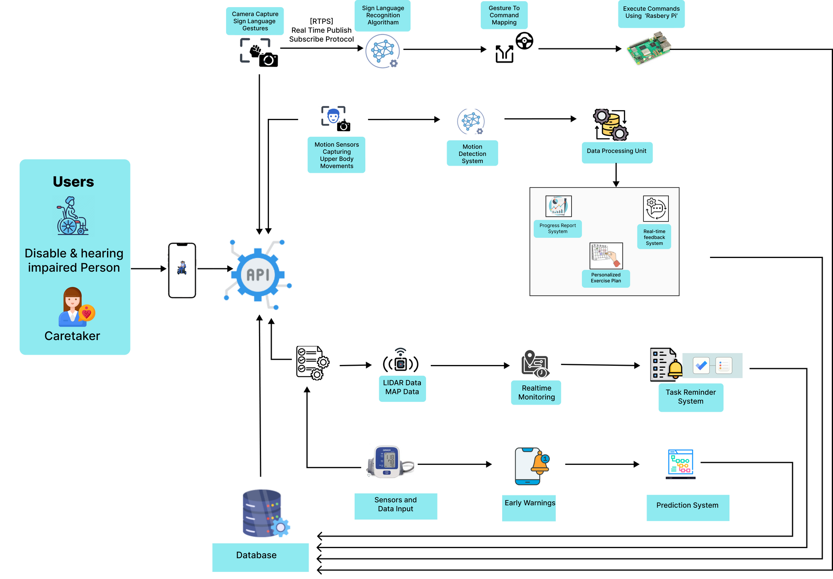
SYSTEM OVERVIEW DIAGRAM

Slide 7


H.G.K.D. PREMATHILAKA
BSc (Hons) in Information Technology

Slide 8
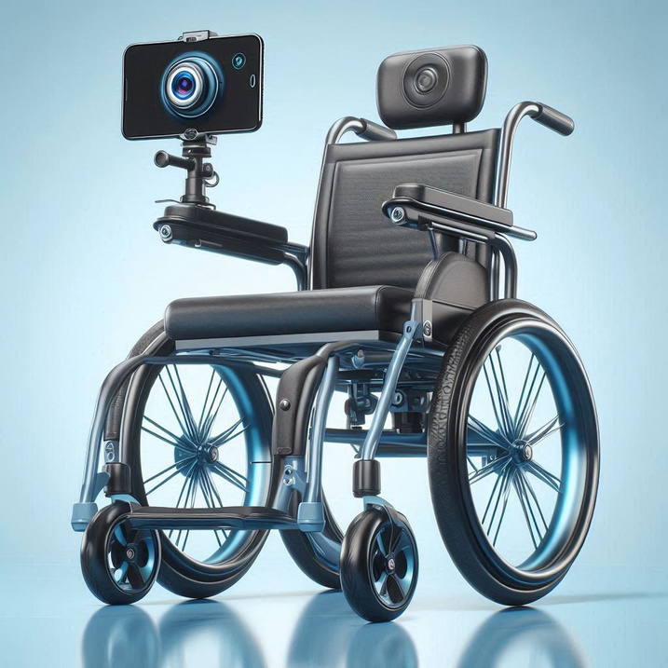
NAVIGATING WHEELCHAIR AND ENHANCING ACCESSIBILITY USING SIGN LANGUAGE-CONTROLLED FOR HEARING-IMPAIRED USERS

Slide 9
RESEARCH PROBLEM
How can wheelchair control systems be designed to effectively cater to hearing-impaired individuals, overcoming the limitations of traditional and voice-based control methods to enhance accessibility and independence?

Slide 10
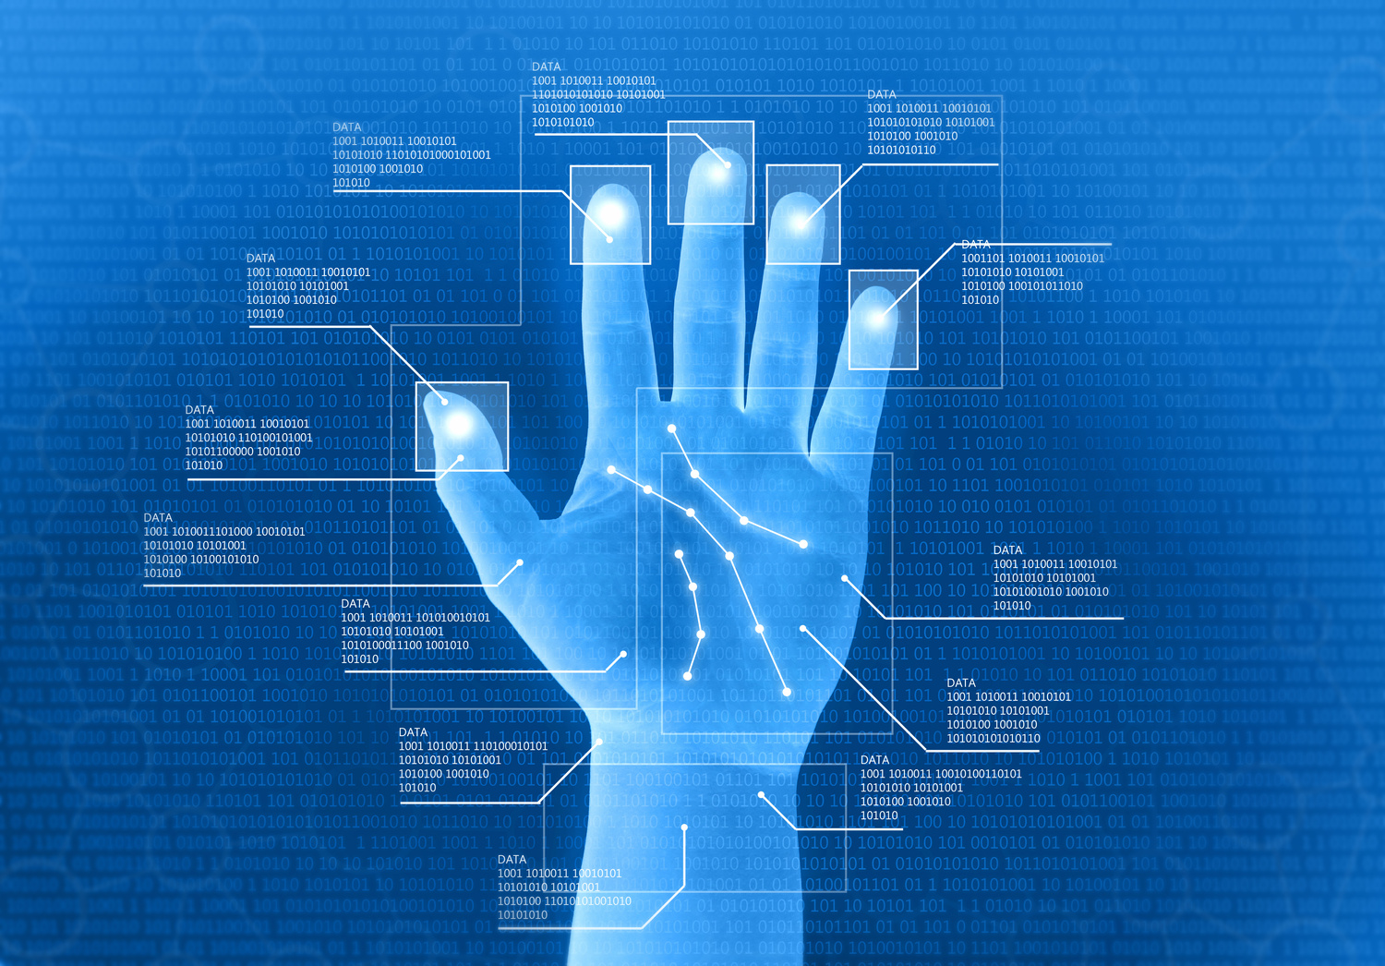
HOW CAN WE OVERCOME THIS?
By integrating advanced computer vision techniques for real-time sign language recognition, we can develop a more intuitive and accessible control system for hearing-impaired users. This will enhance their ability to navigate and operate wheelchairs independently and safely.

Slide 11




INTRODUCTION & BACKGROUND OF THE STUDY
CURRENT WHEELCHAIR CONTROL SYSTEMS
ADVANCES IN COMPUTER VISION
Advances in computer vision enable real-time sign language recognition.
Provides intuitive, accessible control for hearing-impaired users.
Manual and voice-activated wheelchair controls are unsuitable for sign language users.
They require ongoing human intervention.
Not fully accessible for hearing-impaired individuals.

Slide 12

RESEARCH GAP
System/Reference | Sign Language Recognition | Real-Time Gesture Detection | Voice Command Alternative | Culturally Relevant Gestures | Accessible for Hearing-Impaired
[1] Nair et al. (2021) | ❌ No | ✅ Yes | ❌ No | ❌ No | ❌ No
[2] Aizam et al. (2020) | ❌ No | ❌ No | ✅ Yes | ❌ No | ❌ No
[3] Patankar et al. (2023) | ❌ No | ✅ Yes | ❌ No | ❌ No | ❌ No
[4] Kengale et al. (2021) | ❌ No | ❌ No | ❌ No | ❌ No | ❌ No
[5] Deshmukh et al. (2021) | ❌ No | ❌ No | ❌ No | ❌ No | ❌ No
[6] PROPOSED SYSTEM | ✅ Yes | ✅ Yes | ✅ Yes | ✅ Yes | ✅ Yes

Slide 13




SPECIFIC OBJECTIVES
CAPTURE REAL-TIME GESTURES WITH SENSORS AND CAMERAS
PROCESS GESTURE DATA FOR RECOGNITION AND CLASSIFICATION
DETECT AND INTERPRET ONE GESTURE COMMAND AT A TIME
Implement reliable sensors and cameras.
Ensure natural movement is not hindered.
Focus on essential gesture angles.
Develop algorithms to process gesture data.
Use computer vision and machine learning.
Train on annotated datasets for accuracy.
Refine algorithms to detect and interpret commands.
Minimize false positives and negatives.

Slide 14
SPECIFIC OBJECTIVES
INTEGRATE DETECTION SYSTEM WITH WHEELCHAIR CONTROLS
IMPLEMENT ADAPTIVE LEARNING FOR PERSONALIZED RECOGNITION
ENSURE REAL-TIME PROCESSING AND RESPONSIVENESS
Seamlessly connect gesture recognition to wheelchair controls.
Enable real-time, smooth navigation.
Incorporate adaptive learning for personalization.
Continuously learn from user patterns.
Optimize for real-time processing.
Reduce latency for immediate responses.

Slide 15


TECHNOLOGIES, ALGORITHMS
TECHNOLOGIES
ALORITHMS
Python: The primary programming language used for writing code.
TensorFlow: Utilized for machine learning and deep learning applications.
OpenCV: For real-time computer vision tasks, such as reading video frames and performing image processing.
NumPy: Essential for numerical computations and manipulating data arrays.
Node.js: Used for building scalable network applications.
Pandas: Provides data manipulation and analysis capabilities.
OpenPose: Used for real-time multi-person keypoint detection.
MediaPipe: A framework for building perception pipelines, useful for hand and pose tracking.
SVM (Support Vector Machine): A supervised learning model used for classification task

Slide 16
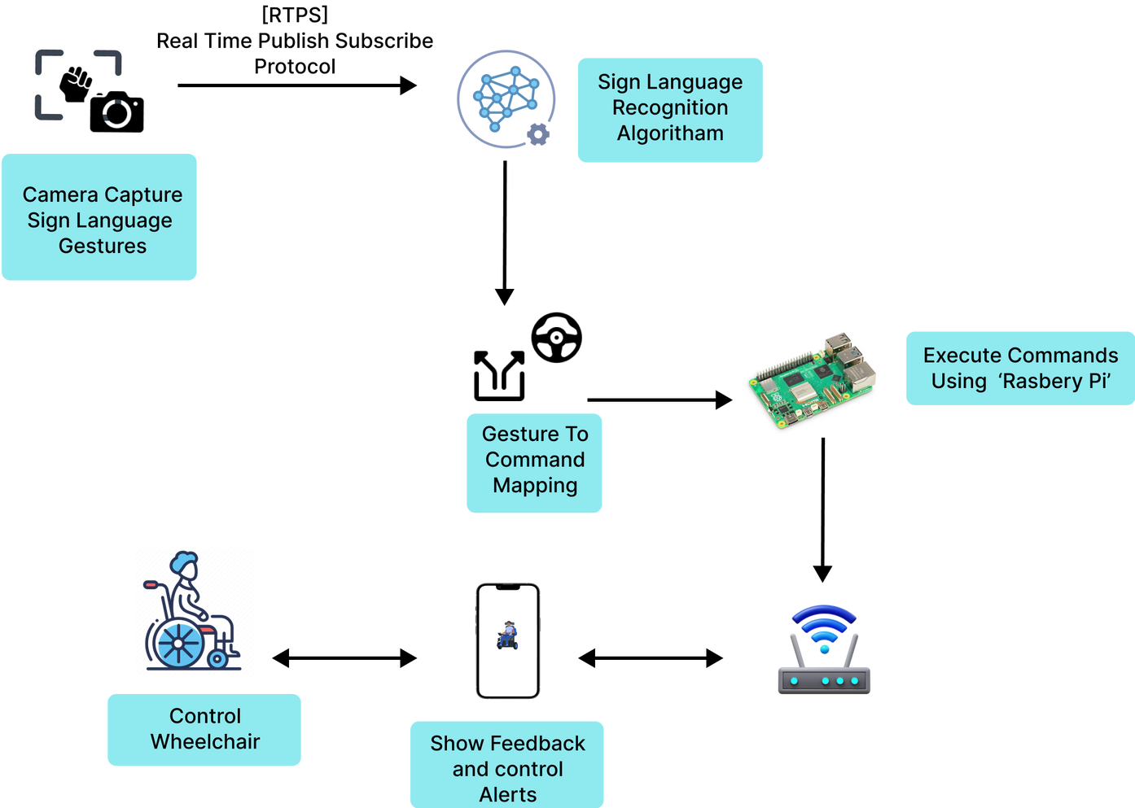
COMPONENT OVERVIEW DIAGRAM

Slide 17
WORK BREAKDOWN STRUCTURE
Sign Language-Controlled Smart Wheelchair
Initial Phase
2. Planning Phase
3. Data Collection Phase
4. Implementation Phase
5. Testing Phase
6. Finalization Phase
1.1 Research on Sign Language Recognition
2.1 Selection of Sign Language Gestures
3.1 Gesture Data Collection🎯
4.1 Dataset Implementation
5.1 Model Testing and Validation
6.1 Documentation
1.2 Requirement Gathering
2.2 Technology Selection
3.2 Environmental Data Collection
4.2 Model Development
5.2 System Integration Testing
6.2 Training and Support
1.3 Feasibility Study
2.3 Risk Assessment
3.3 Data Augmentation
4.3 Integration with Wheelchair Control
5.3 User Acceptance Testing
6.3 Research Paper and Final Report
4.4 User Interface Design

Slide 18
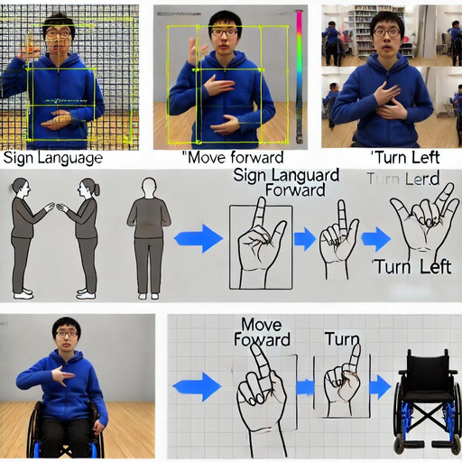
DATASETS
SIGN LANGUAGE GESTURE DATASET
WHEELCHAIR CONTROL COMMANDS DATASET

Slide 19

REFERENCE
[1]Nair, A., Bhatkar, A., Biju, B., Shetty, A., & Thomas, M. (2021). Design and Development of a Smart Wheelchair. 2021 International Conference on Nascent Technologies in Engineering (ICNTE 2021). Fr. C. Rodrigues Institute of Technology, Vashi, Navi Mumbai, India.
[2]Aizam, M. A. M., Hadis, N. S. M., & Abdullah, S. (2020). IoT-Based Smart Wheelchair System for Physically Impaired Person. ESTEEM Academic Journal, Vol. 16, June 2020, 59-73. Universiti Teknologi MARA, Malaysia.
[3]Patankar, N. S., Bhausaheb, G. S., Shaharam, D. A., Satish, P. S., & Deshmukh, T. R. (2023). IoT Based Hand Gesture Control Wheelchair for Disabled Person. Fourth International Conference on Smart Electronics and Communication (ICOSEC-2023).
[4]Kengale, V., Bansod, K., Sure, C., Dalal, M., & Bawane, S. (2021). Designing of a Smart Wheelchair for People with Disabilities. Third International Conference on Intelligent Communication Technologies and Virtual Mobile Networks (ICICV 2021).
[5]Deshmukh, Y. S., Patankar, N. S., Bhausaheb, G. S., Shaharam, D. A., & Satish, P. S. (2021). IoT Based Hand Gesture Control Wheelchair for Disabled Person. Fourth International Conference on Smart Electronics and Communication (ICOSEC-2023).

Slide 20
T.M.S. THENNAKOON
BSc (Hons) in Information Technology

Slide 21
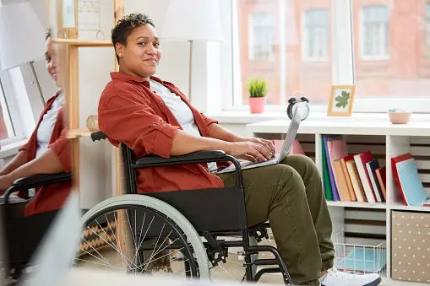
Pathfinding with Real-Time Tracking and Task Reminder System.
The smart wheelchair's pathfinding system uses LIDAR for safe navigation and obstacle avoidance, with real-time tracking and task reminders. Caregivers receive alerts if the user deviates from the path, ensuring enhanced safety and support.

Slide 22
Research Problem
How can a smart wheelchair ensure safe navigation through complex environments, provide timely reminders for daily tasks, and allow caregivers to monitor the user’s location and receive alerts if issues arise?

Slide 23
Introduction & Background of the Study
This research focuses on integrating advanced technologies such as LIDAR-based navigation, real-time tracking, and task reminder systems.
The goal is to create a comprehensive solution that not only ensures safe and efficient navigation but also supports users in adhering to their daily routines while providing caregivers with essential monitoring tools.
The integration of LIDAR with real-time tracking and task reminders represents a novel approach in assistive technology, aiming to fill the gap in existing solutions by enhancing user safety, independence, and caregiver support through continuous monitoring and timely alerts.

Slide 24


RESEARCH GAP TABLE
Comparison of Existing System
LIDAR-BASED
NAVIGATION
REAL-TIME TRACKING
TASK REMINDER SYSTEM
CAREGIVER ALERTS
[1]
[2]
[3]
PROPOSED SYSTEM

Slide 25
SPECIFIC OBJECTIVES
CREATE AN ALERT SYSTEM FOR CARETAKERS WITH CUSTOMIZABLE NOTIFICATIONS
DEVELOP AND IMPLEMENT AN ADAPTIVE PATHFINDING ALGORITHM:
DESIGN A REAL-TIME TRACKING SYSTEM FOR MONITORING WHEELCHAIR LOCATION
Create a dynamic pathfinding algorithm that can adapt to changes in the environment in real time. This algorithm should utilize LIDAR data to detect obstacles and update the path accordingly to ensure smooth navigation.
Design a real-time alert system that notifies caregivers based on specific triggers like path deviations, health emergencies, or task reminders. The system will enable personalized notifications, allowing caregivers to customize alerts to suit individual needs and preferences
INTEGRATE ADAPTIVE LEARNING ALGORITHMS
Develop a GPS-based system for continuous wheelchair tracking, offering real-time location updates to users and caregivers for accurate monitoring and prompt interventions.

Slide 26
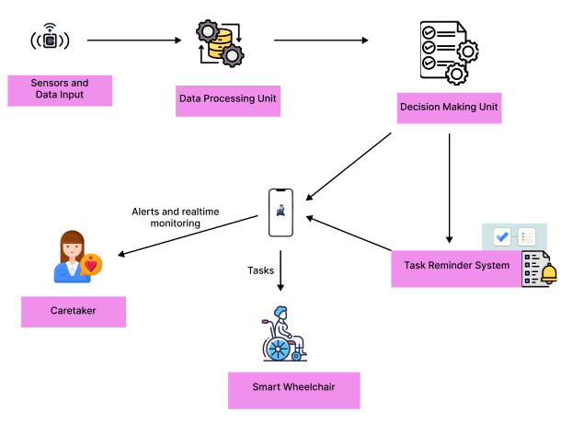
COMPONENT OVERVIEW DIAGRAM

Slide 27
Methodology
TECHNOLOGIES, ALGORITHMS
TECHNOLOGIES
ALORITHMS
Python: The primary programming language used for developing the system, due to its versatility and extensive libraries for machine learning, data processing, and communication.
TensorFlow: Utilized for machine learning and deep learning applications.
OpenCV: For processing LIDAR data and enhancing obstacle detection, enabling the wheelchair to navigate complex environments in real time.
ROS (Robot Operating System): Facilitates the integration of LIDAR and GPS, and supports the development of the pathfinding and tracking system.
Flask: A lightweight web framework used to create APIs for the alert system, enabling communication between the wheelchair and the caregiver’s mobile or web application.
A or D Pathfinding Algorithms:** : To compute the optimal path for navigation, considering dynamic obstacles detected by LIDAR.
Geofencing Algorithms : To define virtual boundaries and trigger alerts when the wheelchair crosses these boundaries or deviates from its planned path.
Dynamic Window Approach (DWA): Used for local obstacle avoidance by considering the robot’s velocity and acceleration constraints. DWA helps in making quick decisions to avoid collisions while following the planned path.

Slide 28
WORK BREAKDOWN STRUCTURE
Pathfinding with Real-Time Tracking and task reminder system.
Initial Phase
2. Planning Phase
3. Data Collection Phase
4. Implementation Phase
5. Testing Phase
6. Finalization Phase
1.1 Research on pathfinding technology
2.1 Selection of environmental data
3.1 Environmental Data Collection🎯
4.1 Dataset Implementation
5.1 Model Testing and Validation
6.1 Documentation
1.2 Requirement Gathering
2.2 Technology Selection
3.2 location and GPS Data Collection
4.2 Model Development
5.2 System Integration Testing
6.2 Training and Support
1.3 Feasibility Study
2.3 Risk Assessment
3.3 Data Augmentation
4.3 Integration with Wheelchair Control
5.3 User Acceptance Testing
6.3 Research Paper and Final Report
4.4 User Interface Design

Slide 29
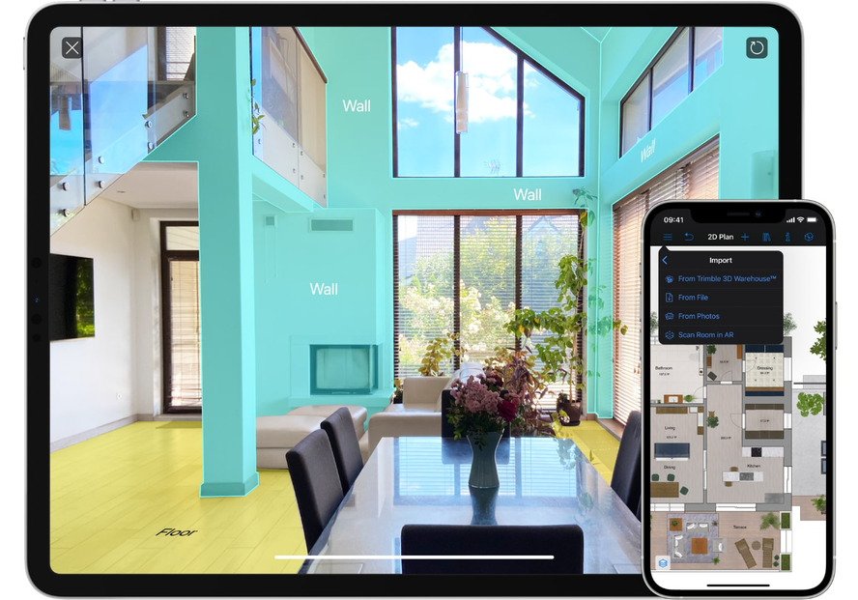
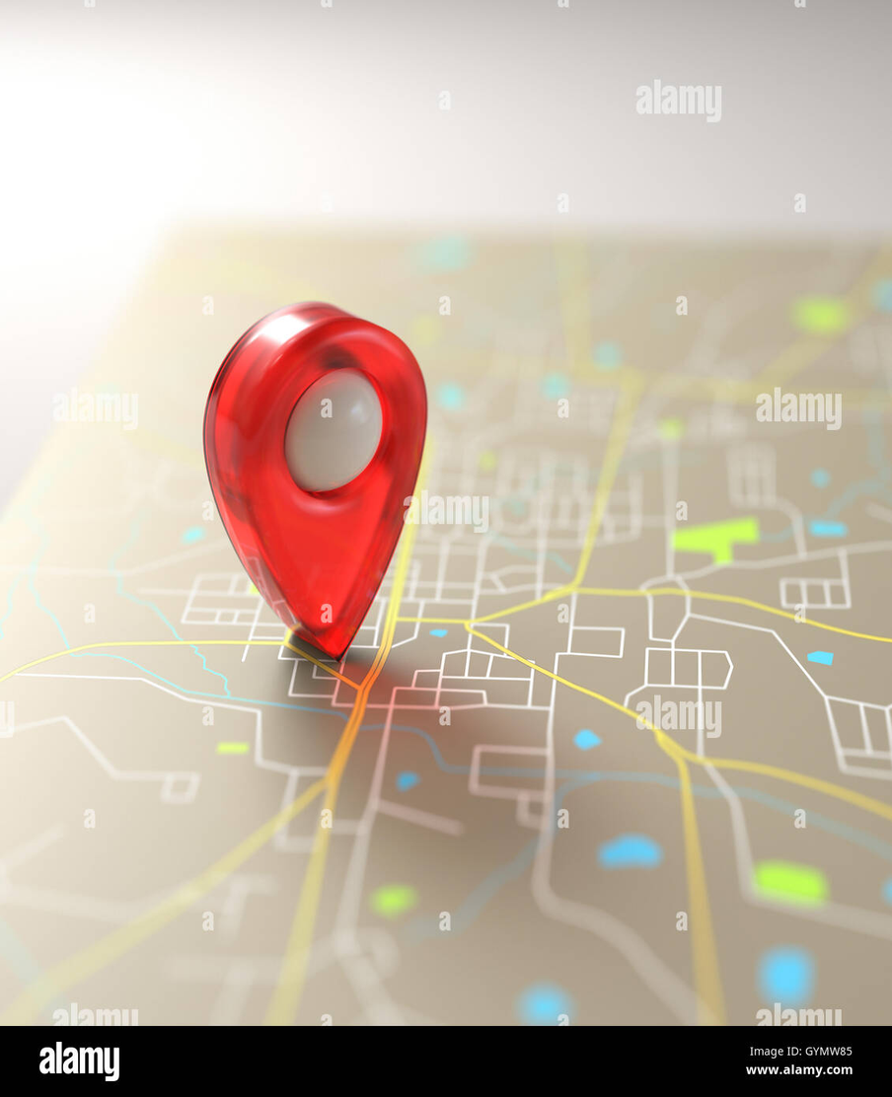

DATASET
FUNCTIONALITIES OF PATHFINDING, REAL-TIME TRACKING, AND TASK REMINDERS.
SENSOR DATA
PATHFINDING DATA
TASK DATA
LIDAR Data
GPS Data
IMU Data
MAP Data
Waypoints Data
Task Schedule
User Preference

Slide 30
REFERENCE
[1] S. Yang, The design and implementation of a scheduler and route planner for wheelchair users, University of British Columbia, 2006..
[2] R.C.Simpson, Smart Wheelchairs, Department of Rehabilitation Science and Technology, University of Pittsburgh, Pittsburgh, PA, 2005
[3] S. M. Mazharul Hoque Chowdhury, Sarnali Basak, Smart wheelchair for disable people, Department of Computer Science and Engineering Jahangirnagar University, 2019
[4 ] Maryam Amur Khalfan Al Shabibi, Suresh Manic Kesavan, IOT for Smart Wheelchair, Department of Electrical and Communication Engineering, College of Engineering, National University of Science and Technology, Muscat, Oman

Slide 31
A.W.D.M.SAMARAWICKRAMA
BSc (Hons) in Information Technology

Slide 32

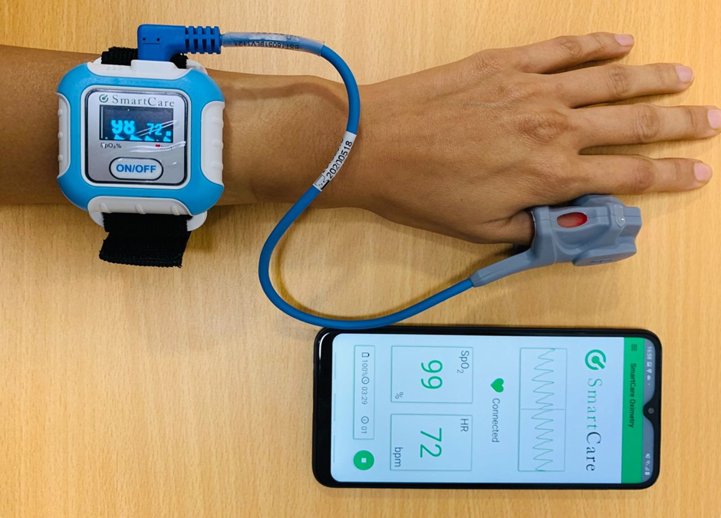
INTEGRATED HEALTH MONITORING SYSTEM
The 'Integrated Health Monitoring System' component continuously monitors the patient's vital health parameters such as heart rate, oxygen level, blood pressure and body temperature every 5 minutes. The system focuses on predicting potential health problems by continuously analyzing this collected data.

Slide 33

HOW CAN WE OVERCOME THIS?
Why is it important to continuously monitors the patient's vital health parameters and How effective is the approach to identifying patient's vital health parameters?

Slide 34
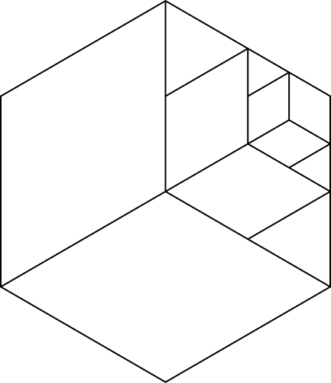
INTRODUCTION & BACKGROUND OF THE STUDY
•A patient in a wheelchair may not get proper physical exercise, so his health condition may change more often than a normal person. To keep the patient in good health, he should be constantly monitored and for that, a caretaker should be employed for the patient.
•To overcome from this gap Integrated Health Monitoring System component is continuously monitors the patient's vital health parameters every 5 minutes and add to a prediction system. The system aims to use specialized sensors for monitoring of health parameters and add to a prediction system.
•This system focuses on predicting potential health issues by continuously analyzing the collected data and it identifies patterns and symptoms, providing early warnings and enabling proactive healthcare interventions.

Slide 35
RESEARCH GAP TABLE
System/Reference | Continuous Vital Monitoring | Predictive Health Analysis | Integrated with Wheelchair | Real-time Data Processing | Comprehensive Health Parameters
[1] | ❌ No | ❌ No | ❌ No | ❌ No | ✅ Yes
[2] | ✅ Yes | ❌ No | ❌ No | ❌ No | ❌ No
[3] | ❌ No | ❌ No | ❌ No | ❌ No | ❌ No
[4] | ✅ Yes | ❌ No | ✅ Yes | ❌ No | ❌ No
[5] | ❌ No | ❌ No | ✅ Yes | ❌ No | ✅ Yes
PROPOSED SYSTEM | ✅ Yes | ✅ Yes | ✅ Yes | ✅ Yes | ✅ Yes

Slide 36
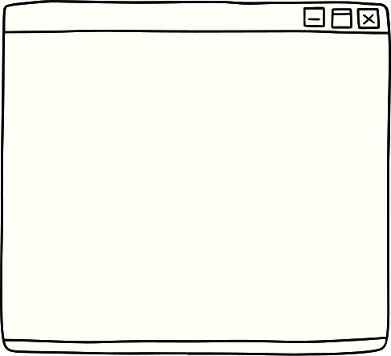
SPECIFIC OBJECTIVES
DEVELOP REAL-TIME HEALTH MONITORING SYSTEM
INPUT DATA TO A PREDICTION SYSTEM
Integrated Health Monitoring System component is continuously monitors the patient's vital health parameters every 5 minutes.
Studying the health status of the patient by entering the collected data into a prediction system.
PROVIDING EARLY WARNINGS
Inform the doctor and caretaker if there is any risk to the patient's health

Slide 37
TECHNOLOGIES & ALGORITHMS
Technologies
Sensors
Microcontrollers & Boards
Communication Technologies
Cloud Platforms
Mobile Applications
Edge Computing Devices
Algorithms
Signal Processing Algorithms
Machine Learning Algorithms
Deep Learning Algorithms
Predictive Analytics
Data Analysis & Pattern Recognition
Predictive Maintenance Algorithms

Slide 38
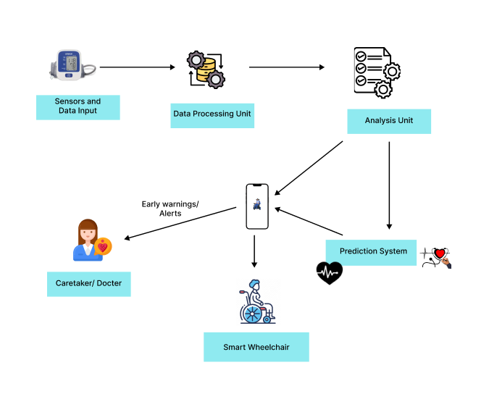
COMPONENT OVERVIEW DIAGRAM

Slide 39
WORK BREAKDOWN STRUCTURE
Integrated Health Monitoring System
1.System Design and Development
2. Sensor Integration and Calibration
3. Data Collection and Storage
4. Data Analysis and Prediction
5. User Interface and Interaction
6. Testing and Validation
1.1 Define system requirements and specifications
2.1 Integrate heart rate, oxygen level, blood pressure, and temperature sensors
3.1 Implement data acquisition system
4.1 Develop data preprocessing techniques
5.1 Design user interface for data visualization
6.1 Conduct system testing and validation
1.2 Select hardware components (sensors, data storage)
3.2 Develop data storage and management system
4.2 Train and evaluate prediction models
5.2 Develop user interaction mechanisms (e.g., notifications)
6.2 Evaluate system performance and accuracy
2.2 Develop sensor data acquisition protocols
1.3 Develop data acquisition and processing algorithms
3.3 Establish data security and privacy protocols
4.3 Develop alert generation mechanisms
5.3 Integrate system with external devices (e.g., smartphones, wearables)
6.3 Conduct user acceptance testing
1.4 Develop prediction models and algorithms

Slide 40

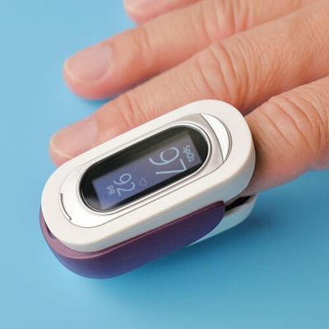
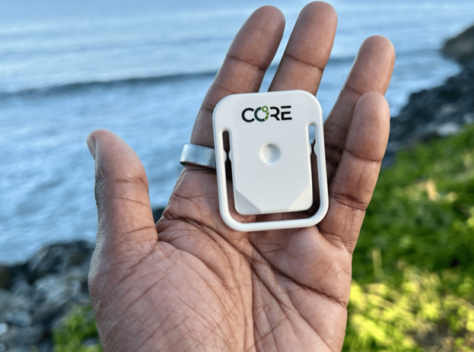
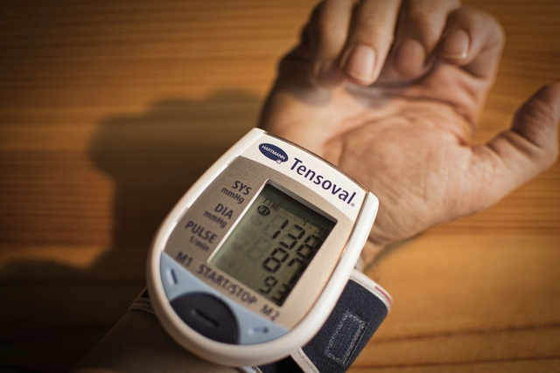
OXYGEN LEVELS
DATASET
HEART RATE
BLOOD PRESSURE
MONITORS THE PATIENT'S VITAL HEALTH PARAMETERS
BODY TEMPERATURE

Slide 41
REFERENCE
[1] D. S. D. S. Dr.Megha Singh, A Novel Electronic Wheel Chair Design using Artificial, 2024 5th International Conference on Intelligent Communication Technologies and Virtual Mobile Networks (ICICV), 2024.
[2] Mr. N.Ram Kumar, HEALTH MONITORING AND ALERTING SMART WHEEL CHAIR FOR PHYSICALLY DISABLED, RAVI KUMAR KANURI,A. PAVAN SADHGUNA,S.AVINASH,P. DIVYA SRI, 2022-2023.
[3] D. S. P. Shripad Deshpande, Embedded system design for real-time interaction with smart wheelchair, 2016 Symposium on Colossal Data Analysis and Networking (CDAN), 2016.
[4] F. Q. M. A. N. I. S. S. a. F. S. Zuhra Bano, Innovating an IoT-Integrated Wheelchair for Mobility and Health Monitoring in People with Different Abilities, Institute of Biomedical Engineering and Technology, LUMHS, Jamshoro, Pakistan, Published: June 30, 2023.

Slide 42
S.N. BENTOTAGE
BSc (Hons) in Information Technology

Slide 43
ADAPTIVE PERSONALIZED EXERCISE PLAN AND REAL-TIME MOTION DETECTION
This component focuses on integrating adaptive, personalized exercise plans into a Smart Wheelchair. Using real-time motion detection, the system continuously monitors upper body exercises, particularly targeting the neck, providing immediate feedback to ensure exercises are performed accurately and effectively. The system adapts to each user’s needs, making rehabilitation more efficient and personalized.

Slide 44
RESEARCH PROBLEM
How can real-time, adaptive feedback mechanisms be integrated into rehabilitation systems to improve the accuracy and effectiveness of upper body exercises for individuals with lower body disabilities and hearing impairments?

Slide 45
INTRODUCTION & BACKGROUND OF THE STUDY
CURRENT REHABILITATION SYSTEMS
ADVANCES IN COMPUTER VISION
The rehabilitation of individuals with lower body disabilities often requires targeted upper body exercises, particularly for the neck, to maintain overall physical health. However, traditional rehabilitation methods do not provide the continuous, personalized feedback necessary to ensure the efficacy of these exercises.
By integrating these technologies into a Smart Wheelchair, users can receive a personalized exercise plan and real-time feedback that adapts to their specific needs, improving the quality of rehabilitation.

Slide 46
RESEARCH GAP TABLE
System/Reference | Upper Body Exercise Focus | Real-Time Motion Detection | Adaptive Feedback Mechanisms | Neck Exercise Specialization | Personalized Exercise Plans
Wilroy et al. [1] | ✅ Yes | ❌ No | ❌ No | ❌ No | ✅ Yes
Sol et al. [2] | ✅ Yes | ❌ No | ❌ No | ❌ No | ✅ Yes
Hwang and Jeon [3] | ❌ No | ❌ No | ❌ No | ❌ No | ❌ No
Beomsoo and Doyoung [4] | ❌ No | ❌ No | ❌ No | ❌ No | ❌ No
Lee et al. [5] | ❌ No | ❌ No | ❌ No | ❌ No | ❌ No
PROPOSED SYSTEM | ✅ Yes | ✅ Yes | ✅ Yes | ✅ Yes | ✅ Yes

Slide 47

Develop an adaptive personalized exercise system for the neck integrated into a Smart Wheelchair
01
SPECIFIC OBJECTIVES
Create algorithms that provide real-time feedback and adjust exercise plans based on user performance.
02
03
Design a user-friendly interface that guides users through exercises using visual feedback.
04
Evaluate the system’s effectiveness in improving rehabilitation outcomes for users and generates a progress report.

Slide 48
TECHNOLOGIES, ALGORITHMS
TECHNOLOGIES
ALGORITHMS
Adaptive Motion Detection: Analyzes user movements to detect deviations and provide real-time corrections.
Personalized Exercise Planning: Tailors exercise routines based on user progress and needs.
Real-Time Feedback: Algorithms that provide instant guidance and corrections during exercises.
Data Analysis and Reporting: Processes and analyzes performance data to update exercise plans and generate progress reports.
Machine Learning Models: Trained to recognize and analyze correct exercise forms and movements.
Motion Sensors: Used to capture real-time upper body movement data.
Python: Handles the algorithms and data processing.
OpenCV: Framework for real-time motion detection and image processing.
TensorFlow: Used to train machine learning models for motion analysis.
Real-Time Data Processing Units: For immediate feedback on exercise performance.
User Interface Design Tools: For creating interactive feedback interfaces.

Slide 49
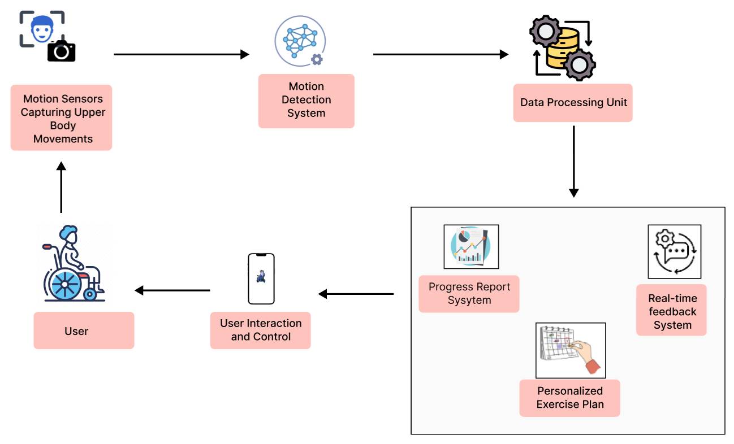
COMPONENT OVERVIEW DIAGRAM

Slide 50
WORK BREAKDOWN STRUCTURE
Adaptive Personalized Exercise Plan and Real-Time Motion Detection
1. Initial Phase
2. Planning Phase
3. Data Collection Phase
4. Implementation Phase
5. Testing Phase
6. Finalization Phase
1.1 Research on Existing Technologies
2.1 Define Real-time Motion Detection Requirements
5.1 Test Real-time Feedback Mechanism with Different Users
6.1 Optimize the Adaptive Exercise Plan System
3.1 Collect Data on Upper Body Movements 🎯
4.1 Implement Motion Detection Algorithm
1.2 Requirement Gathering ✏️
2.2 Technology Selection (Sensors, AI Algorithms)
5.2 Validate the Accuracy of Motion Detection
6.2 Enhance the System Based on Testing Feedback
3.2 Gather Information on Neck Exercises
4.2 Build Adaptive Feedback System 🔍
Feasibility Study
2.3 Develop a Personalized Exercise Framework
6.3 Prepare Final Reports 📝
3.3 Record User Interactions for Adaptive Feedback
4.3 Integrate Feedback Mechanism with Exercise Framework
5.3 Unit Testing of Adaptive Feedback
📝
Design Feedback Mechanism
3.4 Assemble Dataset for Machine Learning
4.4 Train the System with Collected Data
6.4 Integration into Smart Wheelchair System
5.4 System Integration Testing

Slide 51
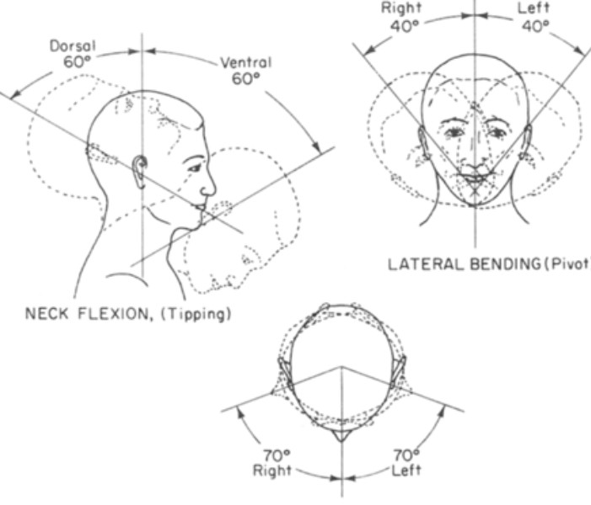
DATASETS
USER MOVEMENT DATA CAPTURED DURING EXERCISES
DATA ON EXERCISE EFFECTIVENESS

Slide 52
REFERENCE
[1] Wilroy, J. D., et al. (2020). "Correlates of adherence in a home-based, self-managed exercise program tailored to wheelchair users with spinal cord injury," Spinal Cord, vol. 59, pp. 55-62.
[2] Sol, M. E., et al. (2021). "The effects of wheelchair mobility skills and exercise training on physical activity, fitness, skills and confidence in youth using a manual wheelchair," Disability and Rehabilitation, vol. 44, no. 16, pp. 4398-4407.
[3] Hwang, B., and Jeon, D. (2012). "A wheelchair integrated lower limb exercise/rehabilitation system: Design and experimental results on the knee joint," IEEE/SICE International Symposium on System Integration (SII), pp. 164-169.
[4] Lee, D., et al. (2013). "Development and preliminary testing of a novel wheelchair integrated exercise/rehabilitation system," IEEE International Conference on Rehabilitation Robotics (ICORR), pp. 1-6.

Slide 53
THANK
YOU

